Slide 1
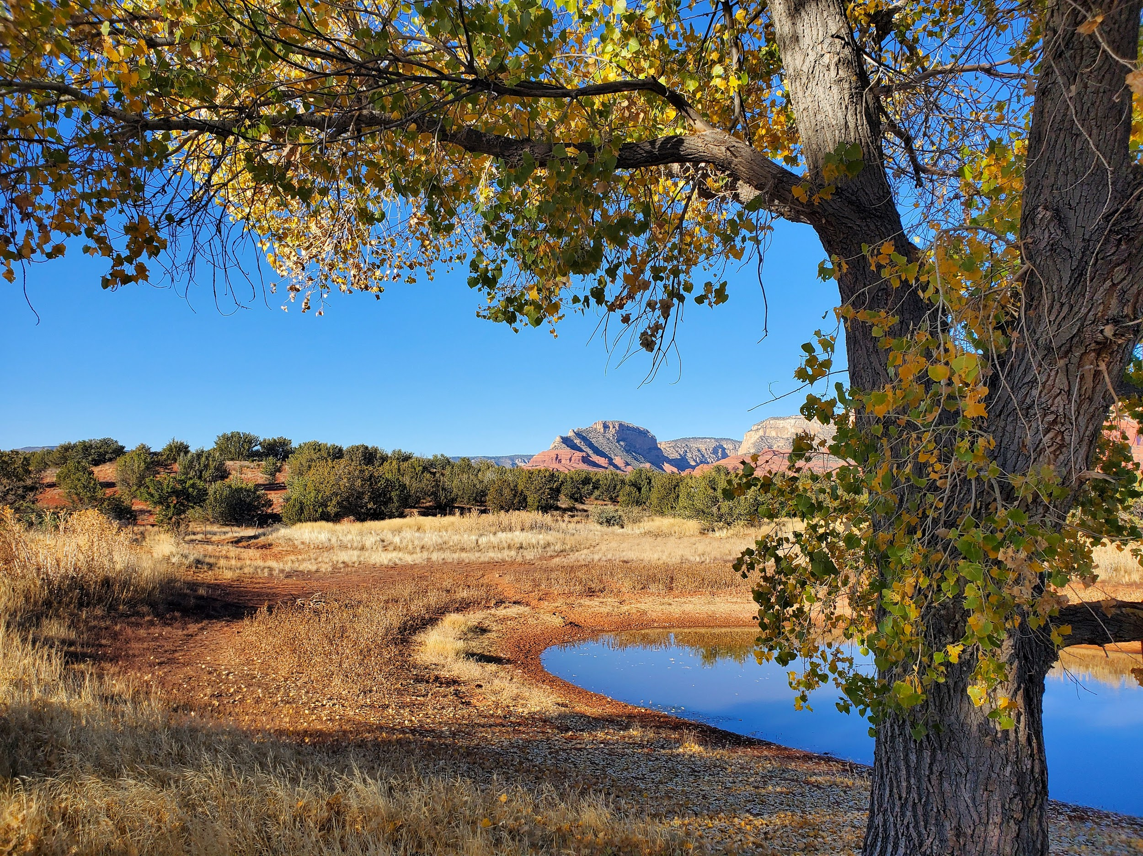
Using eDNA to assess invertebrate biodiversity across a temperature gradient
Dylan Chandler
Rebecca Best
Northern Arizona University

Slide 2
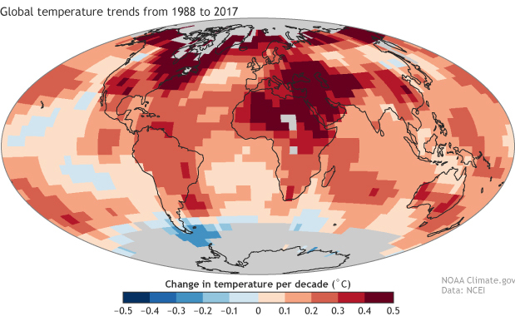
Global Importance
Climate change is rapidly impacting ecosystems around the world
Increasing temperatures are shifting where organisms can live
Need a quick and efficient method of sampling biodiversity to monitor current and future changes

Slide 3
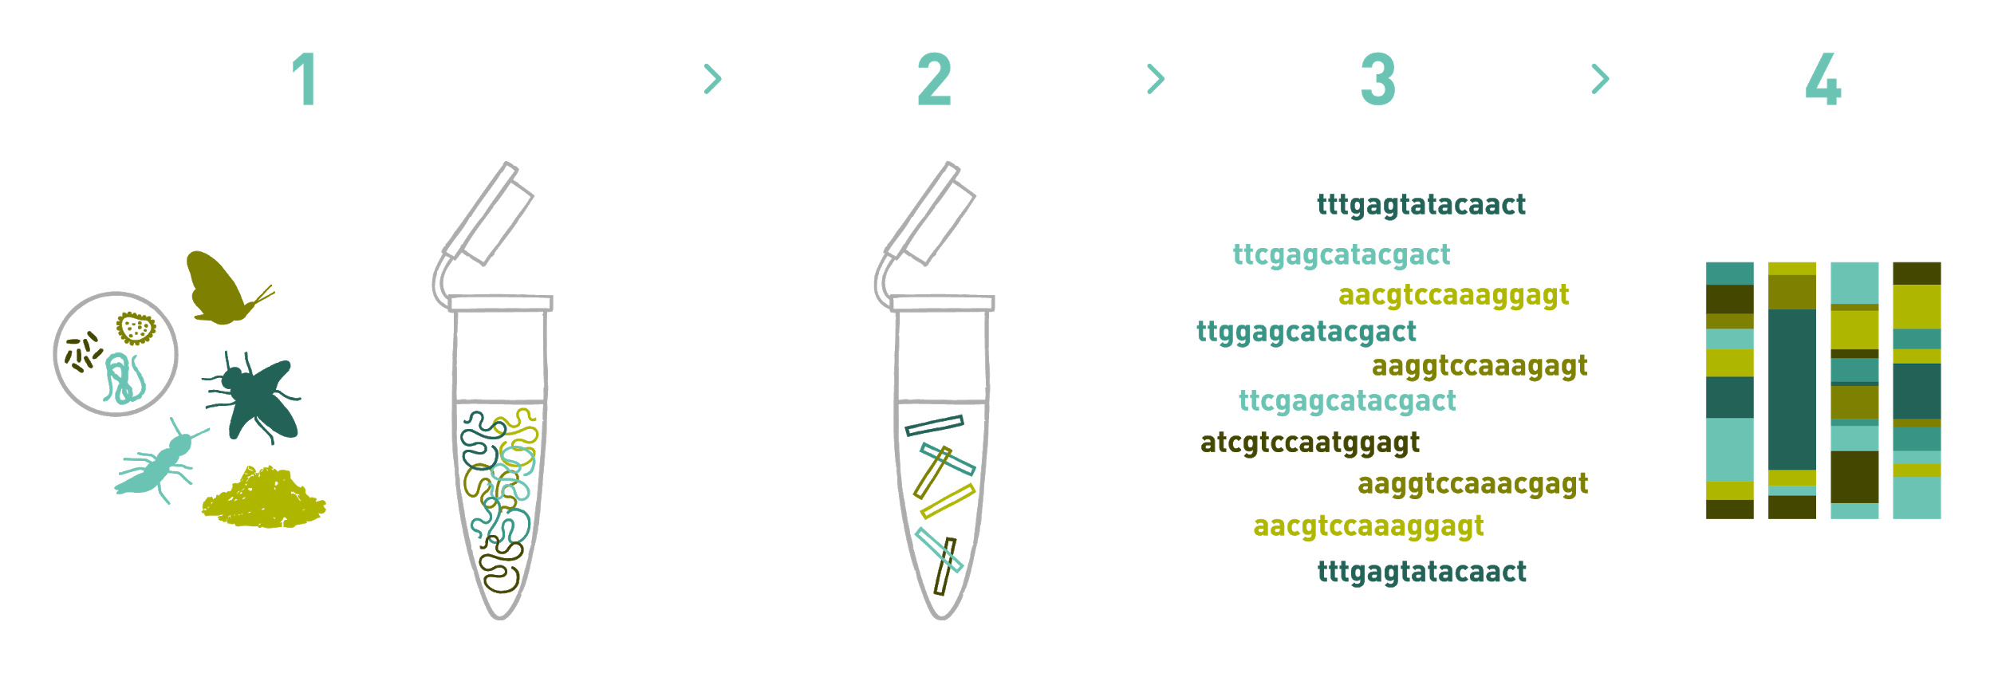
Methods for assessing biodiversity
Traditional method
Field surveys
Collect, preserve, ID
Time consuming, can be costly
eDNA analysis
Genetic material from dead and living cells
Collected, extracted, and sequenced
Quick, relatively cheap
Greater sensitivity
Endangered species, fragile ecosystems
Notes:
Tells us what organisms live and interact with that environment

Slide 4
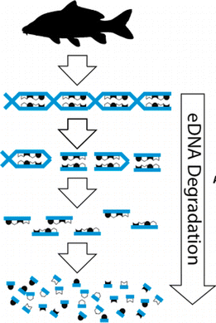
eDNA and water temperature
New technology and method
Temperature significantly affects degradation rate of eDNA
Smaller sequences are harder to identify
Need to better understand before we can use to study temperature effects on biodiversity
Focus- invertebrate diversity in aquatic ecosystems across elevation gradient as a proxy for temperature
Notes:
Many factors affect degradation in natural environments- temperature

Slide 5
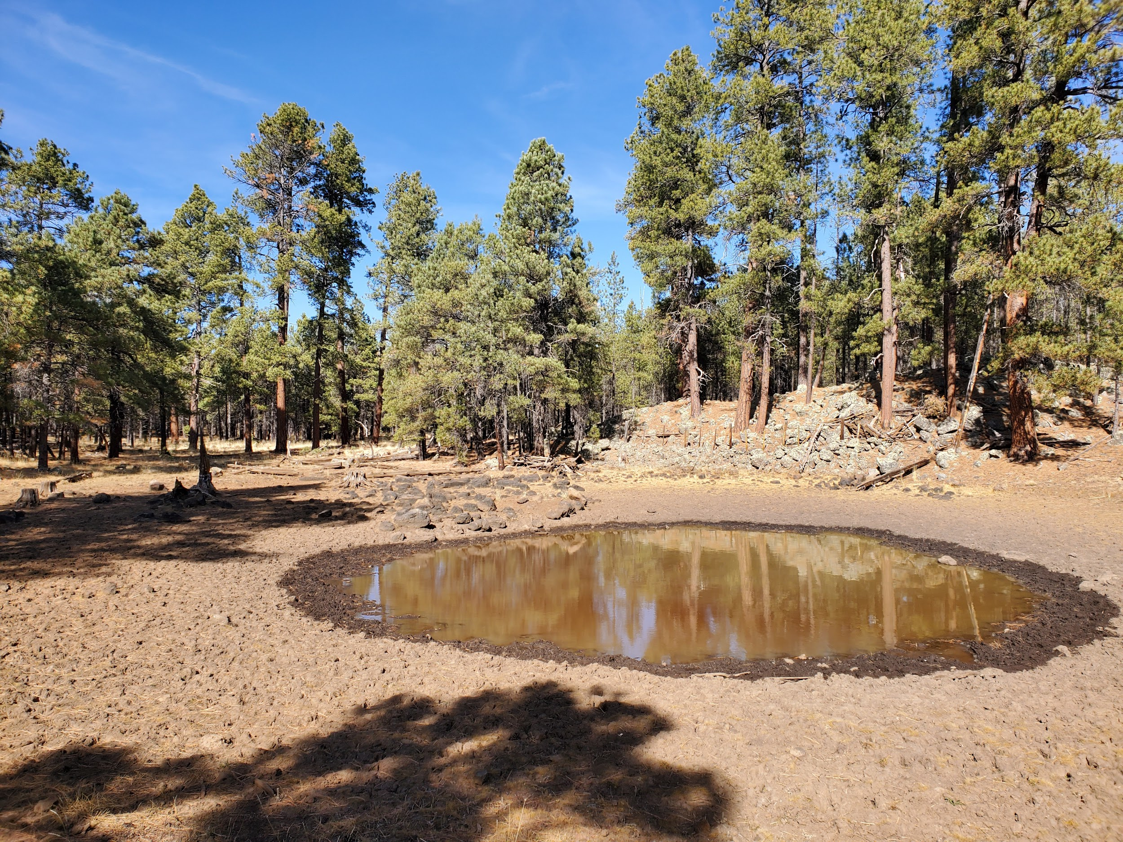
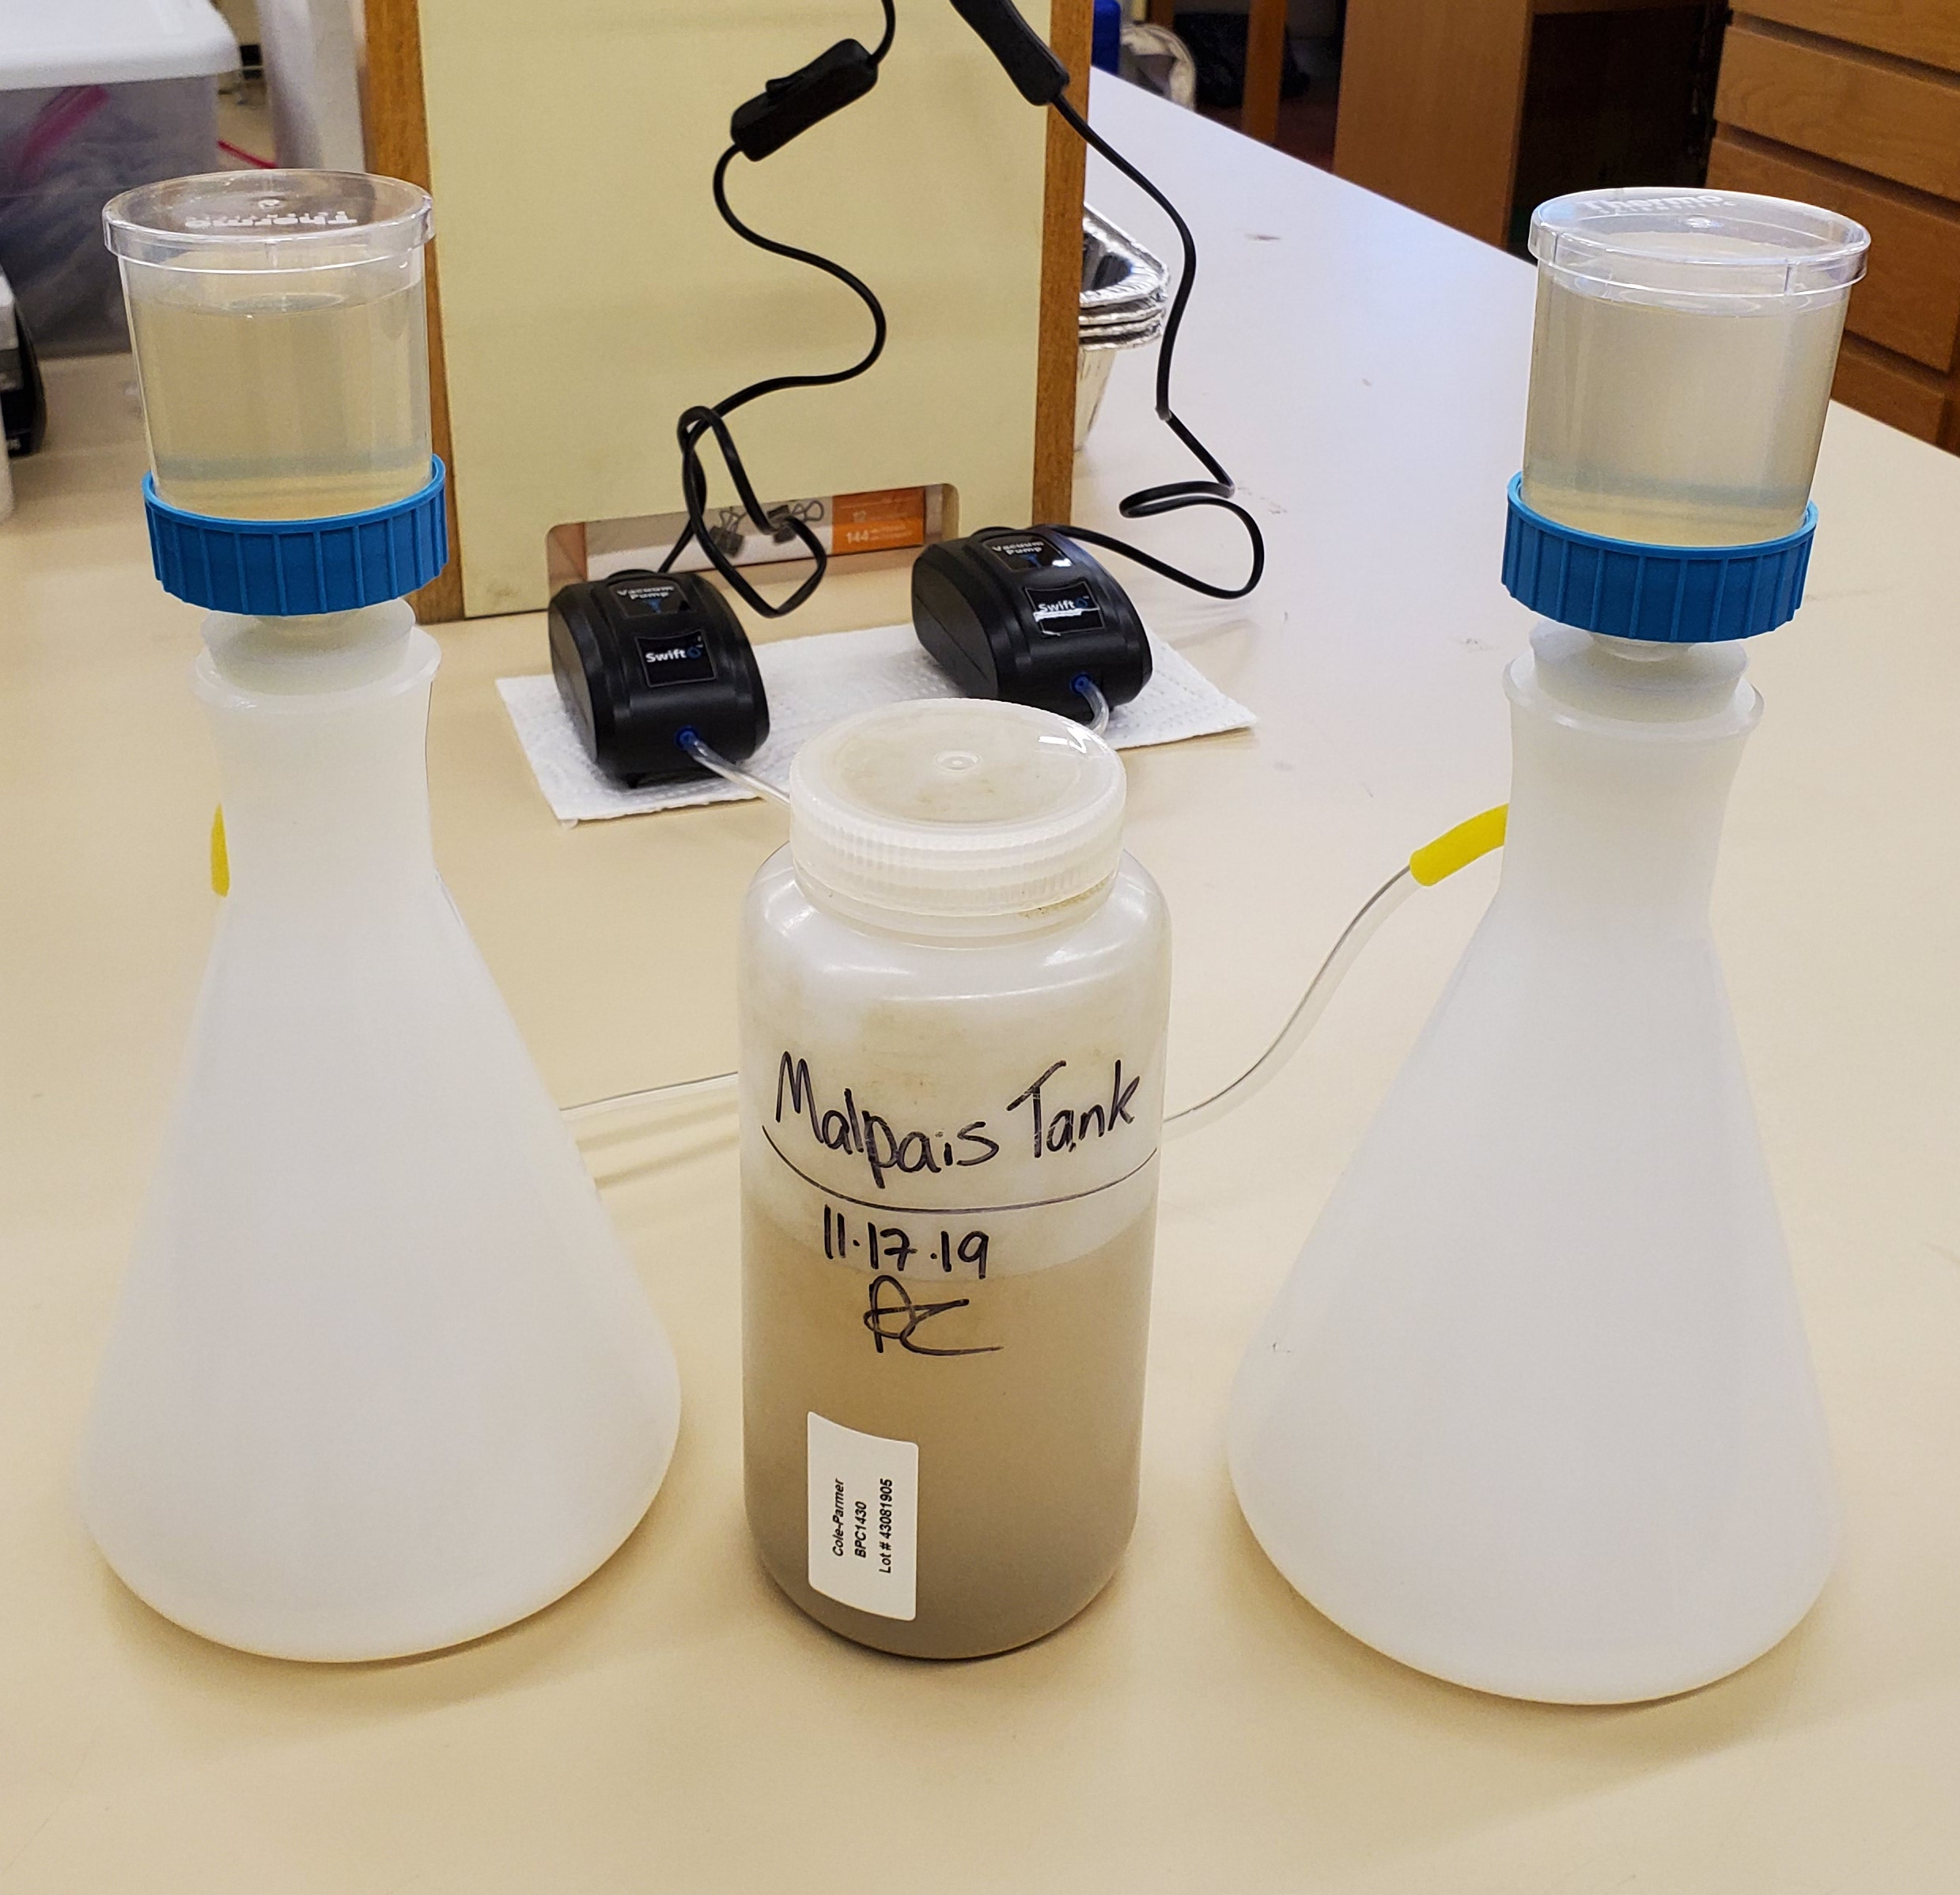
Methods
8 perennial stock ponds sampled in November, after period of highest invertebrate diversity
Vacuum filtered through cellulose nitrate membrane with pore size 0.45 um
DNA extracted using DNeasy kits
Sequenced at mitochondrial COI marker
Notes:
November, after the period of highest invertebrate diversity in fall

Slide 6
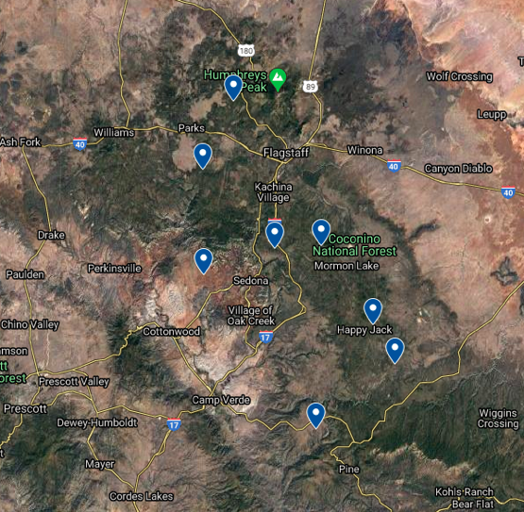

Slide 7
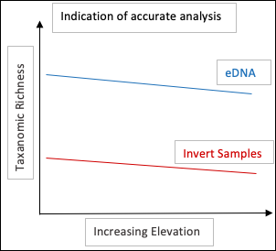
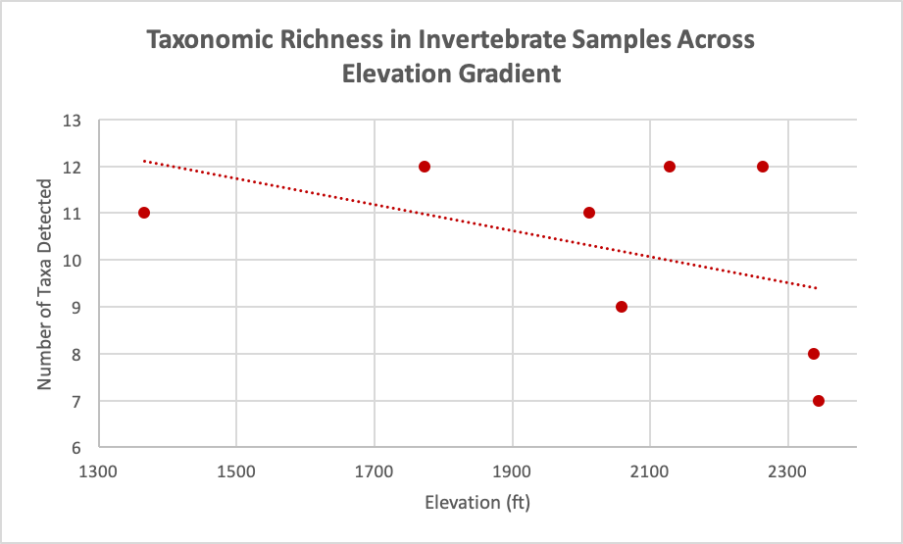
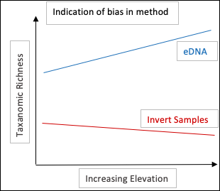
Analysis
Compare patterns of diversity from both methods
Notes:
Assessing diversity pattern in invertebrate samples and eDNA analysis

Slide 8
Conclusion
Continuing with sequencing and analysis
Will compare patterns in taxonomic richness to determine accuracy of eDNA analysis across a temperature gradient
Similar patterns could indicate an efficient new way to monitor biodiversity in aquatic ecosystems impacted by climate change

Slide 9
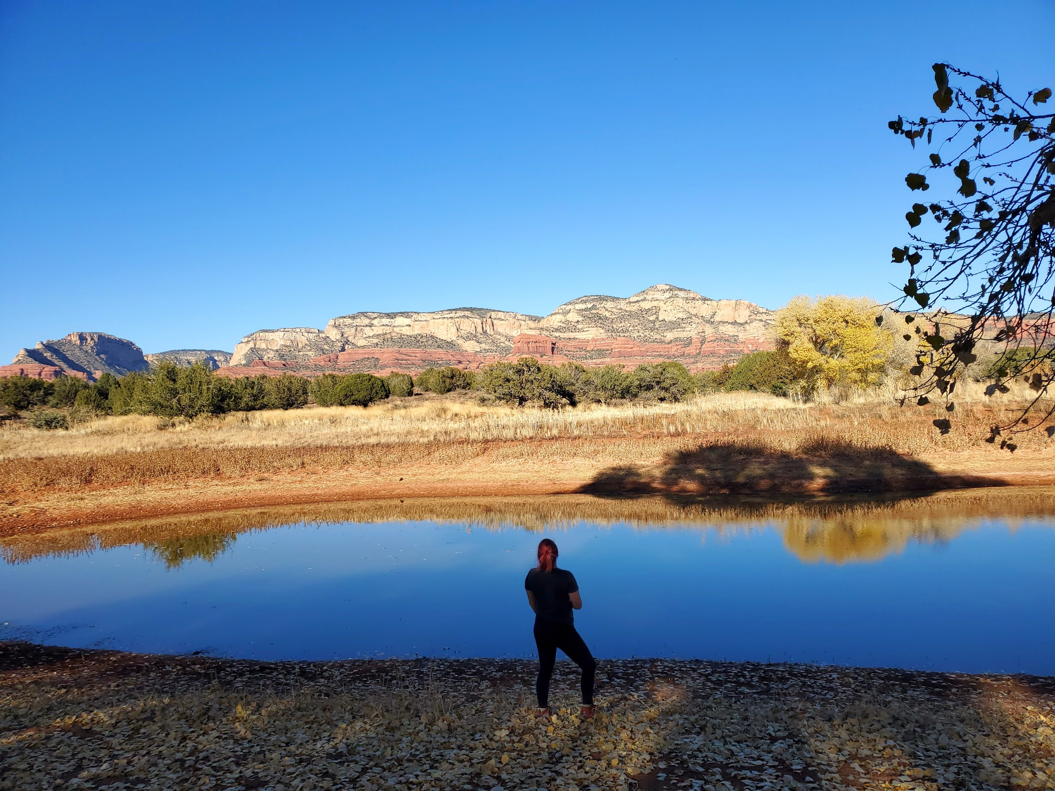
Acknowledgements
Thank you to:
NASA Space Grant
Rebecca Best
Kelsey Banister
Joseph Mihaljevic
Kaitlin Haase
Lela Andrews
Notes:
(mih-Hal-yeh-vic)

